Slide 1
Healthcare Document Data Capture
Capturing content in invoice

Slide 2
Team members:
Indra Shekar G (19z219)
Sanjai M (19z241)
Soumen Saha (19z245)
Vivekanandan (19z261)
Manoj S (19z263)
Mentor:
Ms. A. Bharathi, Asst. Professor
Department of Computer Science And Engineering

Slide 3
Outline
Workflow
KPI’s (Key performance indicators)
Future Development

Slide 4
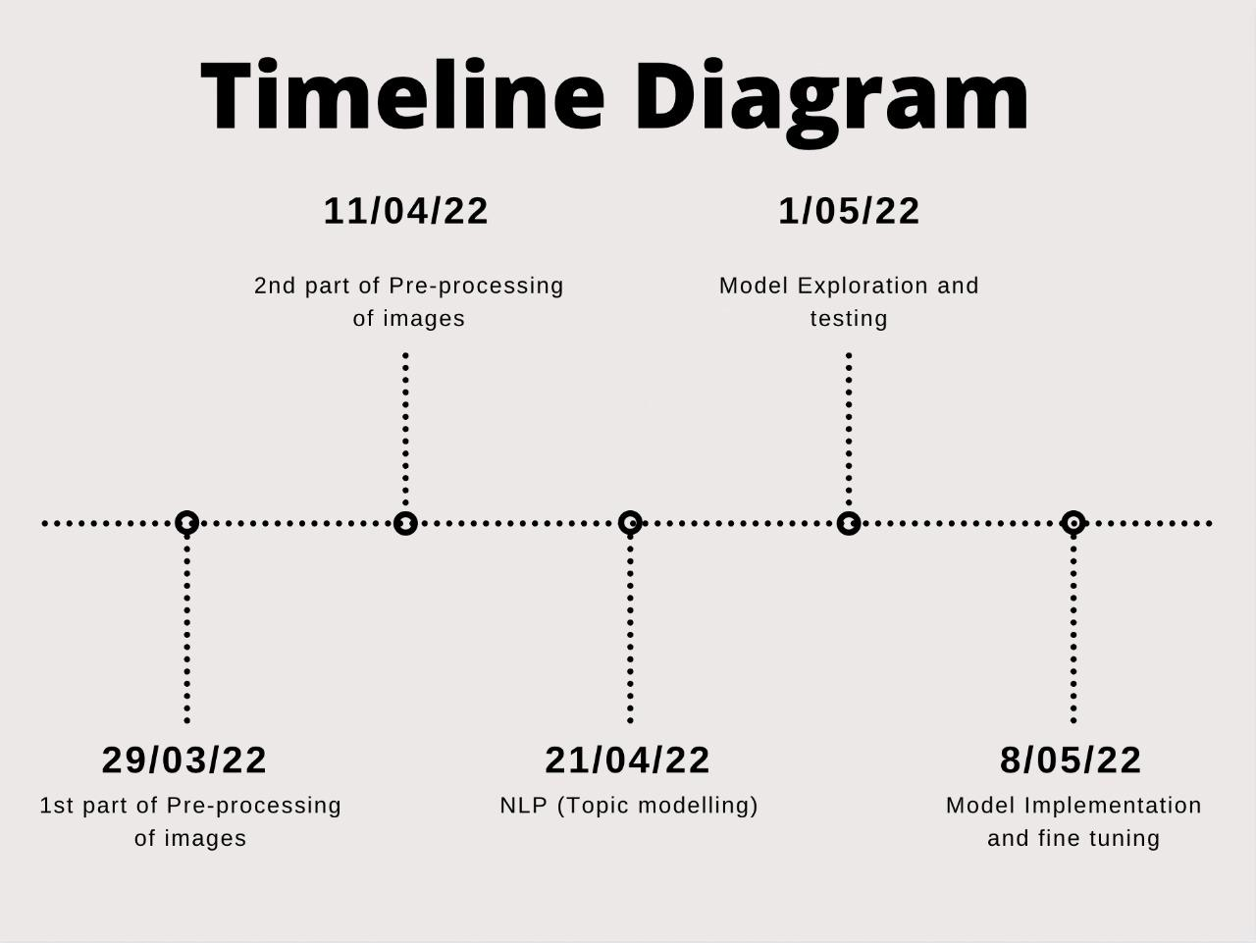
Workflow

Slide 5
KPI’s
Pre-processing
Used digital image for pre-processing
Techniques used:
Coloured image to grayscale
Convert an image from other color spaces to shades of grey
Noise Removal (blurring)
Central element of the image is replaced by the median of all the pixels in the kernel area
Thresholding
Change the pixels of an image based on threshold
Erosion
Removes pixels on object boundaries

Slide 6
Pre-processing
Techniques:
Morph
Difference between dilation and erosion of an image (outline of an object).
Canny edge detection
Detect the edges in an image.
Skew Correction
Rotating the image to correct for the skew
Template matching
finding small parts of an image which match a template image
Boxing
Drawing rectangle boxes around characters and words in text

Slide 7
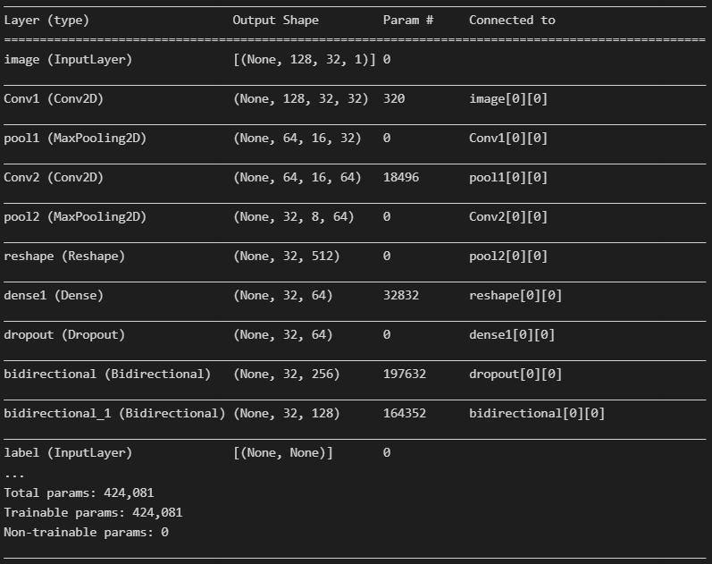
2. Model Training
We created a simple CRNN model using IAM dataset.
Model architecture:
Input Layer - 1
Convolutional layers - 2
Pooling Layers - 2
Reshape layer - 1
Dense Layers - 2
Dropout Layer - 1
Bidirectional layers - 2
CTC Layer - 1

Slide 8
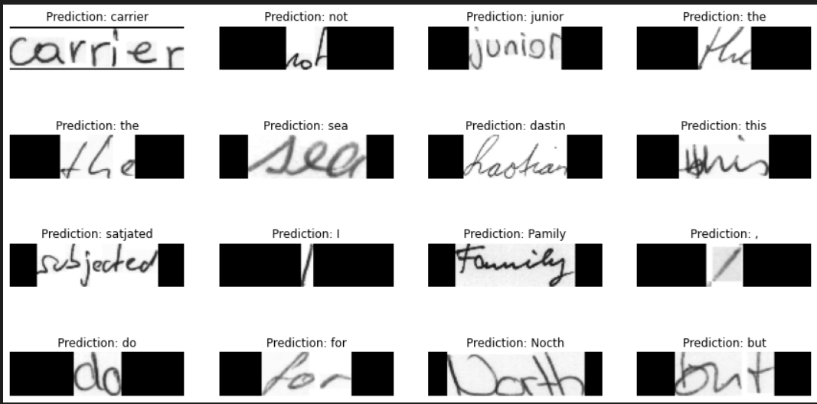
2. Model Training and testing

Slide 9
Future Development
Pre-Processing
To complete line and word segmentation for the bills.
NLP
Topic modeling (topic information retrieval from text)
Model Testing
Testing the model with various sample bills
Post processing
Transforming the predicted text into a particular format

Slide 10
Thank you

